Slide 1
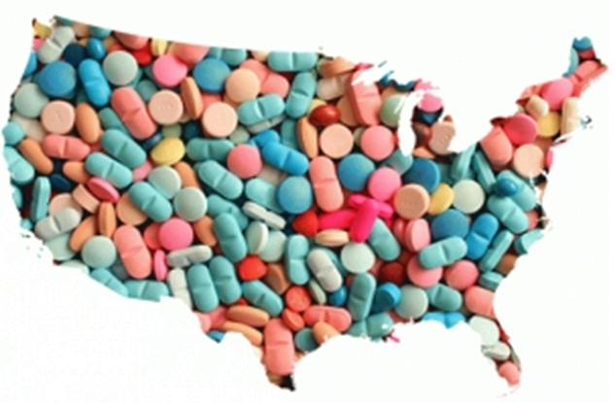

Know the Signs: When and How to Talk about Drugs
Hosted by: Family Support
Notes:
[Agenda]
Thank introducer
Thank the bank
Thank attendees
I used to work at Barclay’s
Ben died on May 4, 2013
Started a non profit
3 NYC 3 NJ
Goal
Young Children

Slide 2

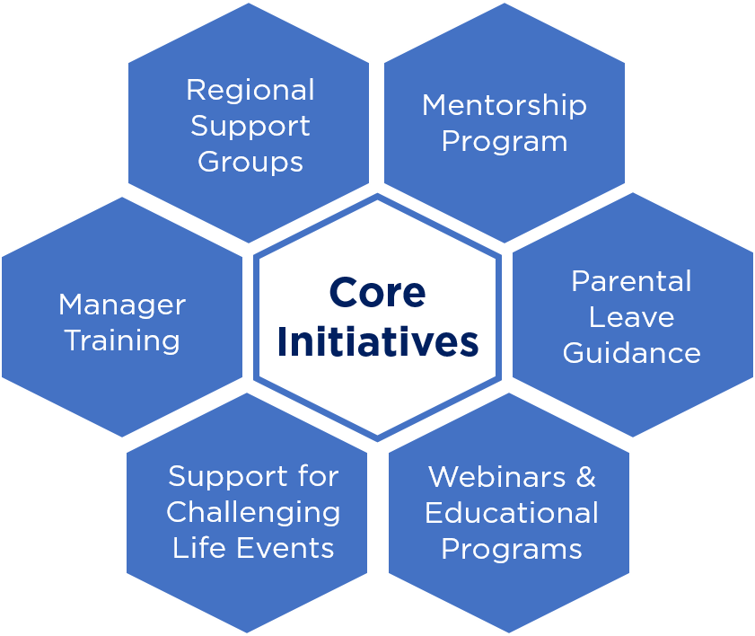
Intro to Family Support
DIOC Working Group
Created to help employees navigate family life while working at TransPerfect
More information can be found:
Central > HR > Family Support Hub
Email FamilySupport@transperfect.com

Slide 3
Who Will Benefit?
If you plan on having children
If you have young children
If you have teenagers
If you have elderly parents

Slide 4
About Me.
My mom was petrified of alcohol
My wife heard stories about her grandmother’s brother / alcoholism
My dad had learning disabilities and sleeping disorder
I have sleeping disorder (hypersomnia)
I have learning disabilities, both dyslexia and ADHD
I have an addictive personality
We knew that Ben had ADHD, sleeping disorder, impulsive and addictive personality

Slide 5
Who’s At Risk? 14-45 & Elderly
Addictive personality
Impulsive personality
Learning disability
Sleep disorder
Mental disorder
Family history of addiction/alcoholism or any of the above
Social problems (bullied)
** Early childhood trauma/abuse **
** Live in pain, perceived or actual (physical or emotional)

Slide 6
What is Addiction?
A chronic disease
One’s need to act despite harmful consequence to one’s well being
Not limited to substance abuse
Attacks the decision center of our brain
Cannot be controlled with will power
21 years old is a magic age

Slide 7
Path to Opiate Addiction.
Drugs are everywhere and easily accessible
We are more comfortable believing, “It’s not my problem!”
As parents, we all talk to our children about drugs infrequently and we tend to exaggerate
Path to drug addiction:
Teens will try drugs because they are finding themselves
Economics drive pain killers to heroin and fentanyl
Addiction affects the entire family

Slide 8
Your Child Starts Using.
We as parents do not know
If you do find out that your child is using, be your child’s best advocate
Be careful not to be an enabler
Your goal is to have your child want to quit using
Make sure that you do not alienate your child
Approaching your child with a negative attitude will not end positively
If you loose a child, you need grief counseling

Slide 9
How to Talk to our Children: Take Action.
What is the right age to talk to your children? How often?
Role play how your children handle situations: school dance, party, any gathering with no adult present
Your child is offered a pill or a drink
Your child sees someone who has a blast on drugs
Someone pushes hard on your child to take a pill or drink
Discuss the code of conduct among students where a student will not reveal another student

Slide 10
How to Talk to our Children: Continued.
A doctor gives your child (or you) an opiate pain killer prescription
Suggestion: Agree to rescue your child—role play
Role play the situation where your child comes home and says: “I messed up. I used drugs and I need help.”

Slide 11
What to Do if Your Child Uses
Drugs, the substance, aren’t the only cause for addiction. Isolation, hopelessness, and trauma are better predictors of drug use
Naloxone, process of overdosing
Expect your child to be in denial
Recovery is a five year process OR MORE
Find a support group
NA and Nar-Anon (equivalent of AA and Al-Anon)
Protect the rest of your family
Your own sanity
You and your spouse
Other siblings
Telemedicine

Slide 12
What to Do if Your Parent is addicted
Your parent drug medicine should be inaccessible to your children
Potentially, by the time you know about it, the addiction has been in effect for a while
You may need an elderly advocate
Telemedicine

Slide 13
It is your responsibility to keep yourself and your children safe.
Doctors may not know best
Someone who is recovering from addiction may not know best

Slide 14
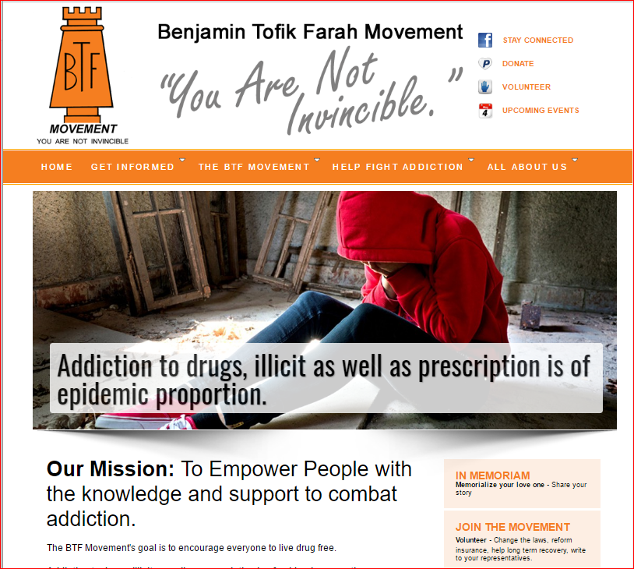
The BTF Movement.
www.btfmovement.com
info@btfmovement.com
Notes:
[References]
You can contact me though the web site
Tena, Sidney
Volunteer, teen, Sidney was 14
Accurately scale addictiveness
If you know of a town / school I would love to be invited

Slide 15
References.
Expert explains why drug overdose deaths soared to record 93,000 amid pandemic (msnbc.com)
Dr. Lee: Pandemic has 'certainly' made opioid crisis worse (msnbc.com)
Dr. Nora Volkow’s YouTube videos (heads the National Institute on Drug Abuse (part of the NIH)
Dr. Ruth Potee’s YouTube channel
Grieving episode on TransPerfect Podcast
Under Our Roof: A Son's Battle for Recovery, a Mother's Battle for Her Son (book by Madeleine Dean, Harry Cunnane)
Ted Talk: Why do our brains get addicted?
Ted Talk: Everything you think you know about addiction is wrong.

Slide 16
Any Questions?

